Slide 1
Paper Presentation
Leveraging genre classification with RNN for Book recommendation
Group No. 12
22266016 - Satabdi Rani Debi
Adib Muhammad Amit- RA
Ehsanur Rahman Rhythm - ST

Slide 2
Introduction
Genre classification with RNN for book recommendation
Recommender systems: Collaborative filtering vs. content-based
Review-based recommender system utilizing user-generated content
Deep learning and RNN for improved recommendations
RNN captures context for more accurate genre classification
Review based recommender system proposed using RNN

Slide 3
Related Work
Recommender systems: successful application of machine learning.
User-based collaborative filtering: similarity between users
Item-based collaborative filtering: similarity between items
Matrix factorization: efficient algorithm for large datasets
Genre classification using RNN for book recommendations

Slide 4
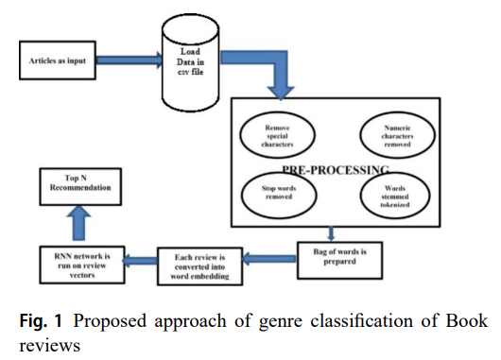
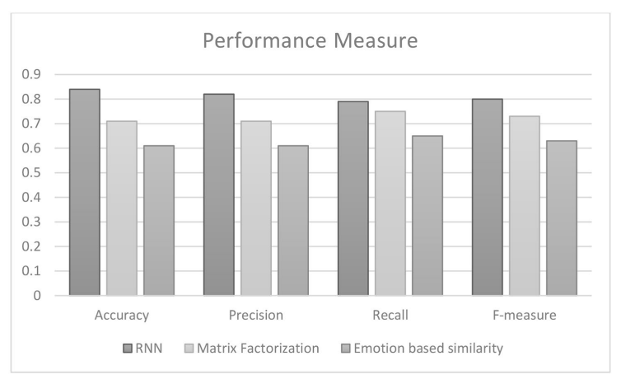
Proposal Approach
Proposed Approach-
Input Data
Preprocessing of review corpus
Recurrent Neural Network
Genre Classification based on RNN Model

Slide 5
Experimental Result
Results demonstrate improved precision with RNN-based recommendation
One hot encoding and feature scaling applied for dataset preprocessing
RNN architecture used with appropriate parameters for genre classification
Recurrent Neural Network outperforms matrix factorization approach
Deep Learning RNN model enhances accuracy and reduces validation loss
Adib Muhammad Amit- RA
Ehsanur Rahman Rhythm - ST

Slide 6
Conclusion
Reviews are input to trained RNN model
Genres generated based on book reviews
Dataset from Amazon used for reviews
Books classified into genres for recommendations
Recommendations extend to other entertainment aspects
Adib Muhammad Amit- RA
Ehsanur Rahman Rhythm - ST

